Slide 1


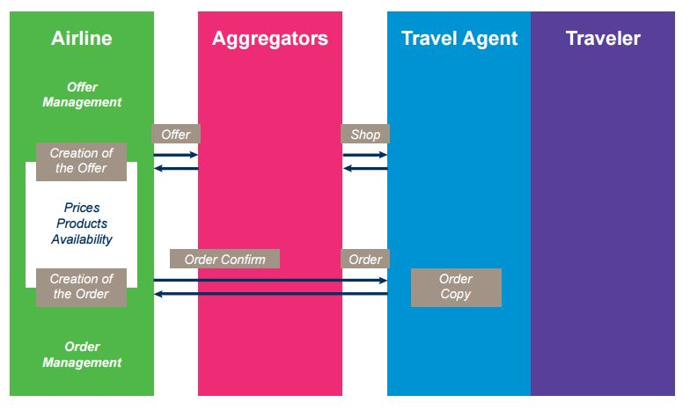
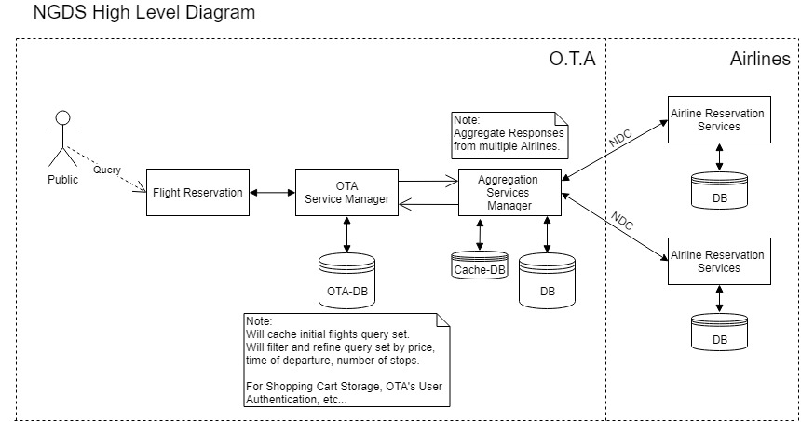
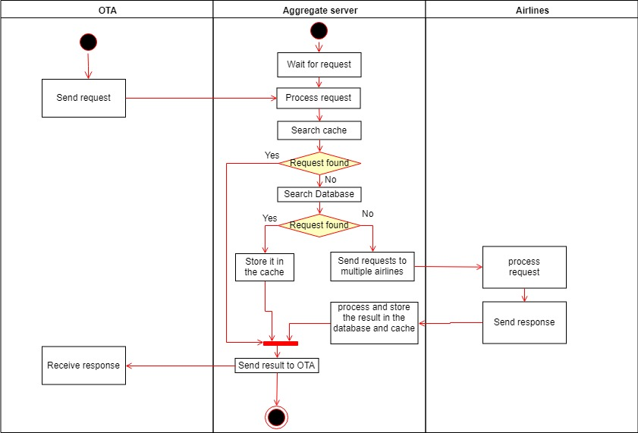
School of Computing & Information Sciences
Fall 2018 Senior Design Project
New Airline Data Exchange Simulation (NAGDS) Version 1.0
Students: Gonzalo Mera, Florida International University
Mentors: Dr. Miguel Alonso , Dr. Steven Luis
Instructor: Dr. Masoud Sadjadi, Florida International University
Problem
Current System
Requirements
The OTA cannot hit multiple airline for one request.
The OTA cannot store requests.
Different OTAs can request the same flight
Requesting the same thing increases the monetary cost.
Make the aggregate server hit multiple airlines
Make it send multiple requests
Store those requests in a database and in the cache
Receive request from OTA
Search the request in the cache
Search the request in the database
Retrieve response from cache or database
System Design
Implementation
Node JS
Express API frame work
MongoDB database
Verification*
Validate NDC XML request
Validate the request from the OTA
Validate the response from the Airlines
Object Design
Summary
The OTA sends a request to the aggregate server.
The aggregate server searches the request in the caches and the in the database.
If the request is not found, it will send it to multiple airlines and store the responses.
Store the response in the database and cache
Then send the result to the OTA.
Acknowledgement
I would like to thank Dr. Steven Luis, Dr. Miguel Alonso and Dr. Masoud Sadjadi.
I would also like to thank my teammates who helped me understand Express and XML
And also special thanks to Farelogix for the help in this project.

